Slide 1
Slide 1
2023 Annual
Riverside County EMS Agency
Policy and Protocol Updates
Notes:
These can be changed to reflect your school’s specific rules.

Slide 2
Presentation overview
Policy Manual Housekeeping
Policy Manual header
Agency Signatures page
REMSA Policy #1207 (Paramedic Accreditation)
ALS and BLS Skills Competency Verification Packet link locations
REMSA Policy #6103 (Ambulance Diversion) and #6104 (APOD Ambulance Redirection) Refresher
REMSA Policy #8301 (Policy Review Process)

Slide 3
Presentation overview (Cont.)
Policy Manual Updates
Update to pediatric medication administration language in all treatment protocols
Individual Medication Updates | Policies Affected
Activated Charcoal | #3303, #4105, #4601 & #4603
Adenosine | #4403
Calcium Chloride | #4302, #4601, #4603 & #4702
Dextrose | #4201
Epinephrine (drip) | #4405
Naloxone | #4601
Oral Glucose | #4105, #4201 & #4801
Glucagon | #4201, #4406 & #4601
Lidocaine | #4403 & #4405
Ondansetron ODT | #4203

Slide 4
Presentation overview (Cont.)
Policy Manual Updates, cont.
Update to REMSA Policy #3308 (ALS to BLS Downgrade)
Accompanying Education
Update to REMSA Policy #4101 (Introduction to Treatment Protocols)
Language referring to the Calculation Chart / Pediatric Medication Dosing Resource
Update to REMSA Policy #5301 (Trauma Triage Indicators and Destination)
Addition of new MOI, physiologic, and Co-morbid factor criteria
Update to REMSA Policy #7701 (Patient Care Records)
COMING SOON: Secondary informed consent signature panel related to patient enrollment in referral intervention programs
Pediatric Medication Dosing Resource Review
Name Change
Introduction Page Review
New layout examples

Slide 5
Housekeeping: Policy Manual Header
Previous header
Current header
Purpose:
Easier to update (gets rid of unnecessary and redundant information that can be displayed elsewhere)
Creates more space on the page
Makes it clear the last time a policy or protocol was reviewed and / or revised

Slide 6
Housekeeping: Agency Signatures Page
Purpose:
(Again) Easier to update (we only need to update this page once every few years, in one policy, instead of ALL policies)

Slide 7
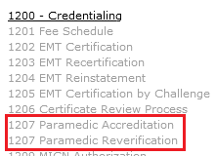
Housekeeping: REMSA Policy #1207 Paramedic accreditation
Combined #1207 and #1208 (Paramedic Reverification) due to redundant information in both policies
Reorganized the new policy to have a more sequential flow
#1208 no longer exists as a link
ADDED:
Updated definitions – Local Accreditation, Initial Accreditation,
Reinstatement of Accreditation and Verification / Reverification of Eligibility
Fee table added directly into the policy
REMINDER!
As discussed at the November 28th 2022 PMAC for July 1, 2023 go-live…
PALS / PEPP and PHTLS / ITLS are already required. This update simply aligns #1207 with policies #3101 (First Response Agencies) and #3202 (Transport Services)

Slide 8
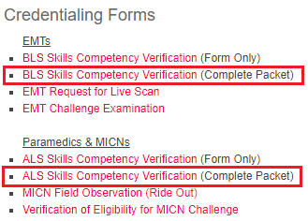
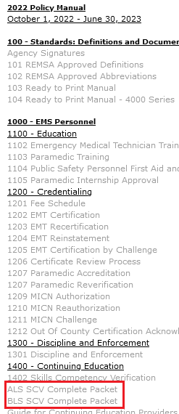
Housekeeping: ALS & BLS Skills Competency Verification Packet link locations
https://rivcoems.org/Documents/Reporting-Forms
http://www.remsa.us/policy/2022ALSSCVCompletePacket.pdf
http://www.remsa.us/policy/BLSSkillsCompetencyVerification(CompletePacket).pdf

Slide 9
HOUSEKEEPING:
REMSA POLICY #6103 & #6104 REFRESHER AMBULANCE DIVERSION & APOD AMBULANCE REDIRECTION
What is APOT?
Ambulance patient offload time, or APOT, is the time span between eTimes.11 (Arrived at destination) and eTimes.12 (Transfer of care). The APOT timer begins as soon as the ambulance is marked as "Arrived at destination."
APOT is measured in total hours per day / week / month / year.
What is APOD?
An ambulance patient offload delay, or APOD, is any delay that causes an ambulance's APOT at the hospital to exceed the local standard patient offload time of thirty (30) minutes. An ambulance is considered "on APOD" once their APOT is greater than thirty (30) minutes. This is synonymous with “non-standard patient offload time” as referenced in CA HSC 1797.225.
APODs are measured in total number of events per day / week / month / year (e.g., "Riverside County experienced over 4,300 APODs in December 2022")

Slide 10
HOUSEKEEPING:
REMSA POLICY #6103 & #6104 REFRESHER AMBULANCE DIVERSION & APOD AMBULANCE REDIRECTION (cont.)
What is an extended APOD?
Extended APOD occurs when an ambulance's APOT meets or exceeds ninety (90) minutes after arrival at an emergency department (ED).
What is ambulance redirection?
Ambulance redirection occurs when an emergency department experiences one (1) or more extended APODs, with APOT exceeding ninety (90) minutes or more for one (1) or more ambulances. Ambulances still on scene of a call will be redirected to the next closest most appropriate hospital that is:
Not experiencing extended APODs AND
That is not currently on redirect.
Multiple ambulances with patients on their gurneys waiting to offload at an emergency department, in itself, does not mean that the emergency department is on redirect.

Slide 11
HOUSEKEEPING:
REMSA POLICY #6103 & #6104 REFRESHER AMBULANCE DIVERSION & APOD AMBULANCE REDIRECTION (cont.)
What is the difference between ambulance redirection and ED Closure (EDC)?
Ambulance redirection occurs when the ninety (90) minute APOT threshold has been met, requiring the temporary diversion of ambulances to other, less congested hospitals.
EDCs are initiated when unusual and / or unforeseen events occur, at or within any prehospital receiving center (PRC), that cause a significant disruption in physical plant operations, preventing the ability to treat patients in the ED. Examples of significant disruptions that will result in an ED closure include incidents involving:
The safety and / or security of the facility (active shooter(s) and / or the threat of gunfire, bomb threats and / or explosions, etc.) | Critical damage to physical infrastructure(s) and / or systems that would impact patient care
A power outage AND a nonfunctional backup generator | A hazardous materials exposure
A disruption or contamination of the facility’s water supply | Flooding or fire
The REMSA Duty Officer must be contacted immediately ((951) 712-3342) when any of the events listed above have occurred.
Examples of events that do NOT qualify as significant disruptions in physical plant operations include staffing shortages (immediate, short- or long-term), lack of available inpatient beds, an outage of internet and / or intranet connectivity (including the use of an EHR system, i.e., “downtime”), etc.

Slide 12
HOUSEKEEPING:
REMSA POLICY #6103 & #6104 REFRESHER AMBULANCE DIVERSION & APOD AMBULANCE REDIRECTION (cont.)
What if we're on redirect but we're the closest stroke / STEMI / trauma center to a patient that needs stroke / STEMI / trauma services?
REMSA Policy #6103 – Ambulance Diversion
REMSA Policy #6104 -
APOD Ambulance Redirection
*Hospitals on EDC should make every effort to accept a specialty care patient if/when possible
What if we're on redirect or EDC but the patient explicitly requests to be transported here?​
If your ED is on redirect, it is imperative that the transporting paramedic explains the extended offload delay times that your facility is experiencing. They must also ensure that the patient understands what they are being told; however, if they insist, transport to your facility is permitted.

Slide 13
HOUSEKEEPING:
REMSA POLICY #6103 & #6104 REFRESHER AMBULANCE DIVERSION & APOD AMBULANCE REDIRECTION (cont.)
Are there any patients that can still be transported to our ED, even if we are on EDC?
YES. Patients experiencing unresolved anaphylaxis, an unmanageable airway (i.e., EMS personnel are unable to effectively ventilate with a bag-valve-mask (BVM)) and/or uncontrolled non-traumatic hemorrhage will still be transported to the closest ED UNLESS the EDC is caused by critical damage to physical infrastructure(s) and/or systems that would impact patient care.
But what if we're a base hospital and we're on redirect or EDC and we're the closest stroke / STEMI / trauma center to a patient that needs stroke / STEMI / trauma services? Or we're on redirect and the patient explicitly requests to be transported here?
Regardless of a hospital's status as a PRC or a base station, transporting ALS ambulances cannot be redirected if / when their patient requires stroke / STEMI / trauma services (unless the trauma center is on trauma diversion).

Slide 14
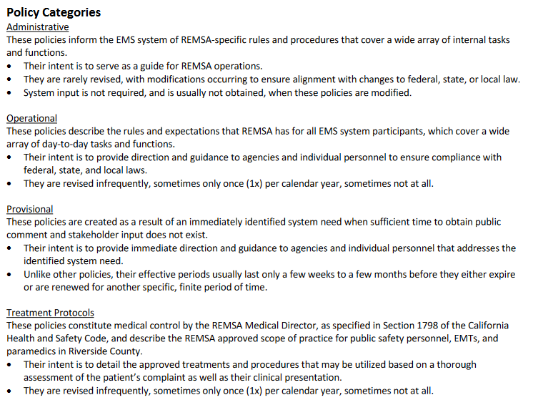
Housekeeping: REMSA Policy #8301 Policy Review Process
Addition of Policy Category definitions

Slide 15
Housekeeping: REMSA Policy #8301 Policy Review Process (cont.)
Reminder: all committees are advisory in nature - final approving authority belongs to the REMSA Medical Director
Takeaway: new steps have been added to the policy and protocol review process to make sure everyone’s time is respected, and that the strongest and most meaningful ideas make it to the public comment period

Slide 16
Housekeeping: REMSA Policy #8301 Policy Review Process (cont.)
Takeaway: to give the most effective argument possible, REMSA recommends brief presentations when making proposals
Takeaway: for a proposal to proceed, a Motion to Discuss and / or a Motion to Proceed are required

Slide 17
Housekeeping: REMSA Policy #8301 Policy Review Process (cont.)
Takeaway: consensus votes are required for proposals to make it into the public comment period. Only these topics, and topics introduced by REMSA, will be open for comment.

Slide 18
Housekeeping: REMSA Policy #8301 Policy Review Process (cont.)
Takeaway: the consensus vote is a recommendation only

Slide 19
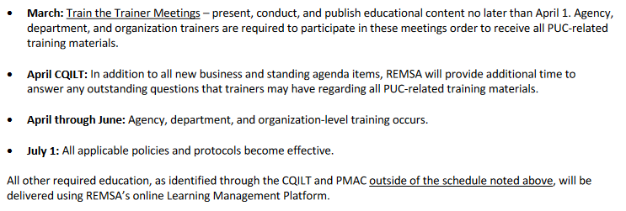
Housekeeping: REMSA Policy #8301 Policy Review Process (cont.)

Slide 20
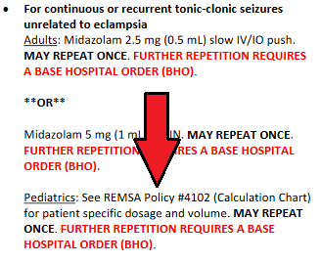
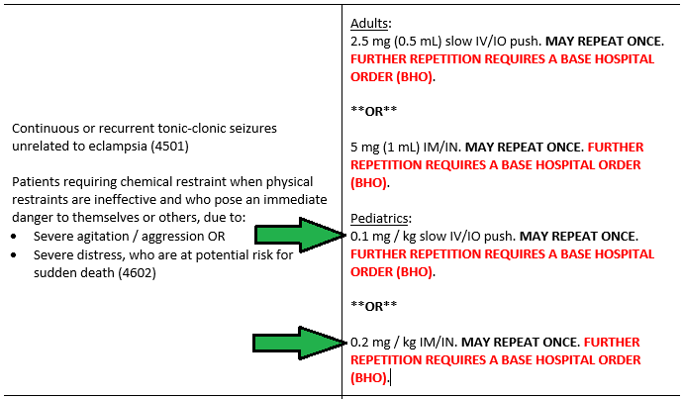
Update: pediatric medication administration language
Current language in REMSA Policy #4105 (ALS Drug Index) and #4501 (Seizures)
Changed to align with updated Calculation Chart / Pediatric Medication Dosing Resource

Slide 21
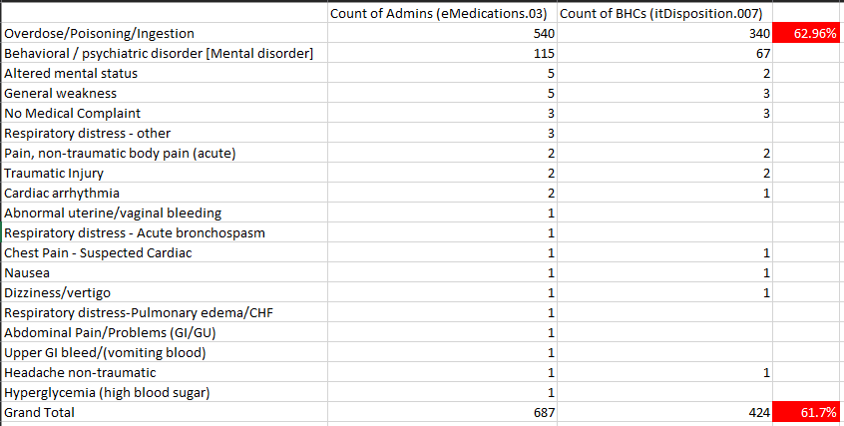
Medication Update: Activated charcoal policies affected: #3303, #4105, #4601 & #4603 change: removal from drug box
Removal of Activated Charcoal from:
Drug and Equipment List
ALS Drug Index
Treatment Protocol: Overdose / Adverse Reaction
Treatment Protocol: Toxic Exposure, Inhalation, or Ingestion
Reason: In 2021 & 2022 combined, there were approximately 350,000 medication administrations total (all meds)
Activated Charcoal administration was documented 687 times (approximately 0.2% of all med administrations)
62.96% of the time was it given for the appropriate indication.
61.7% of the time it was given after receiving a BHO.

Slide 22
Medication update: adenosine policy affected: #4403 change: removal of bho requirement prior to admin for adults and peds
Current language
Updated language
Additionally, the need to contact a base hospital for all patients experiencing symptomatic tachycardia, regardless of its origin, will no longer be required.
Purpose: Adenosine has the shortest half-life of any permitted medication in Riverside County and can, in most instances, be drawn up and administered before the order can be obtained. Waiting to give it could, potentially, lead to untoward patient outcomes due to a delay in appropriate care.

Slide 23
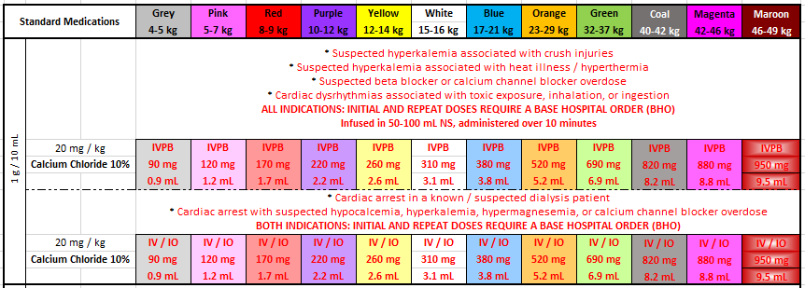
Medication update: calcium chloride policies affected: #4302, #4601, #4603 & #4702 change: change in route of admin for pediatrics to align with adults
Current route is IV only
Updated routes
Purpose:
CaCl₂ can cause hypotension, syncope, significant venous irritation and/or tissue necrosis. Admin by IVPB is required for all patients with pulses.

Slide 24
Medication Update: dextrose policy affected: #4201 change: removal of d25% and d50% as concentrations for admin to adults and pediatrics
Current language
Updated language
Purpose: multiple studies and trials have shown that the administration of D10% is just as effective as D50% in reversing hypoglycemic episodes (Hurtubise et al., 2021); D50%, however, has been found to cause significantly higher blood glucose concentrations both in the prehospital setting and upon hospital arrival (Weant et al., 2019) and may also have theoretical risks including extravasation injury, direct toxic effects of hypertonic dextrose, and potential neurotoxic effects of acute hyperglycemia (Hern et al., 2016). Additionally, one concentration standardizes what can, and will, be administered in the field.

Slide 25
Medication Update: dextrose policy affected: #4201 change: removal of d25% and d50% as concentration options for admin (cont.)
Takeaway:
D25% and D50% are still permitted to be carried; however, they must be diluted to D10% prior to administration in both the adult and pediatric populations.
Step-by-step instructions to dilute at the point of care are included on page 2 of the introduction to the Pediatric Medication Dosing Resource
Dilution of a single medication from one concentration to another does not require base hospital contact

Slide 26
Medication Update: Epinephrine (drip) policy affected: #4405 change: removal of capnography threshold for admin of epi drip
Current language
Updated language
Purpose: The previous capnography threshold unintentionally prevented patients from receiving Epinephrine via IV drip, which may have provided a better outcome to their condition.

Slide 27
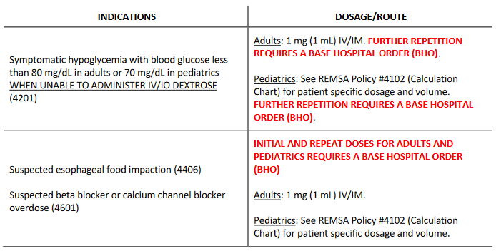
Medication Update: glucagon policies affected: #4201, #4406 & #4601 change: dosing schedule modification for pediatrics only
Current language

Slide 28
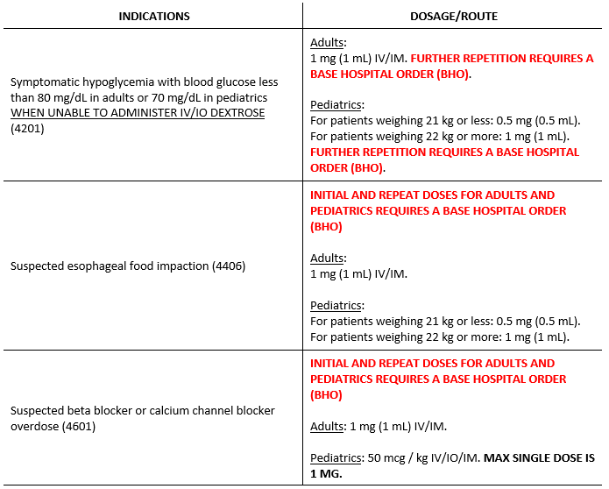
Medication Update: glucagon policies affected: #4201, #4406 & #4601 change: dosing schedule modification for pediatrics only (CONT.)
Updated language
New dosing required for beta blocker / CaCl₂ blocker overdose
NOTE: no change in dosing between 4201 and 4406; however, a new row is needed because of the BHO requirement

Slide 29
Medication Update: glucagon policies affected: #4201, #4406 & #4601 change: dosing schedule modification for pediatrics only (CONT.)
Current dosing schedule:
18 kg or less = 0.5 mg
19 kg or more = 1 mg
Updated dosing schedule:
Purpose: to align with Rady Children’s Glucagon administration protocol / pharmacist recommended dosing
Additionally: dosing for this specific Glucagon indication is documented in mcg (not mg) to remain consistent with the formula.

Slide 30
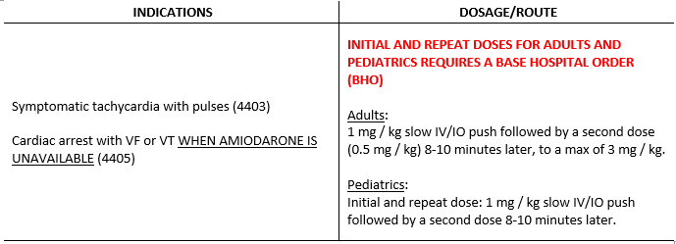
Medication Update: lidocaine policies affected: #4403 & #4405 change: dosing formula modification for adults only
Current language
Updated language
Purpose:
To create a uniform dose for all adults

Slide 31
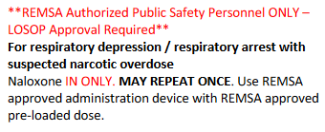
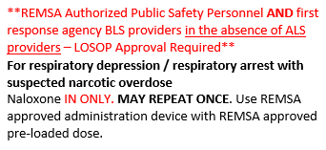
Medication Update: Naloxone policy affected: #4601 change: bls providers permitted to use REMSA-approved intranasal administration device
Purpose: due to the increasing number of BLS response apparatus' responding to ALS medical aids – and arriving on scene prior to an ALS resource – the need for BLS personnel to intervene in opioid-induced respiratory depression must be addressed in order to create better patient outcomes. Permitting First Response agency BLS providers to utilize the REMSA-approved intranasal administration device will do that.
Current language
Updated language

Slide 32
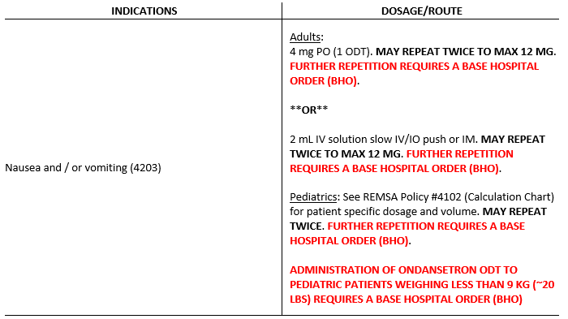
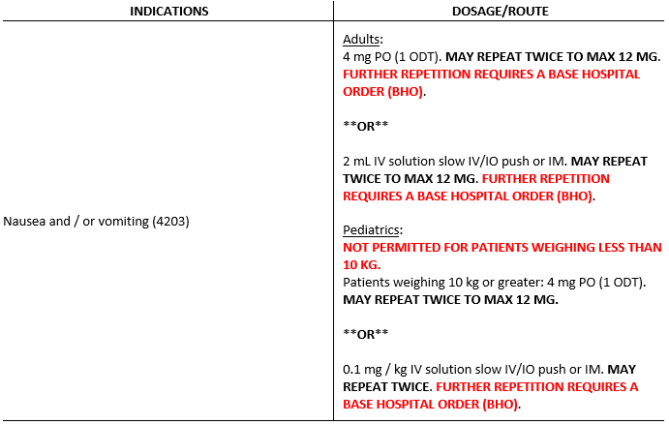
Medication Update: ondansetron odt policies affected: #4203 change: dosing schedule modification for pediatrics only
Current language
Purpose:
*Administration of Zofran ODT in the very young (i.e., less than 1yo population) is a choking hazard.
*To align with Rady Children’s Ondansetron ODT admin protocol / pharmacist recommended dosing
New language

Slide 33
Medication Update: ondansetron odt policies affected: #4203 change: dosing schedule modification for pediatrics only (CONT.)

Slide 34
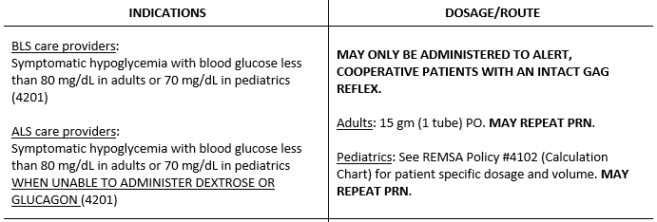
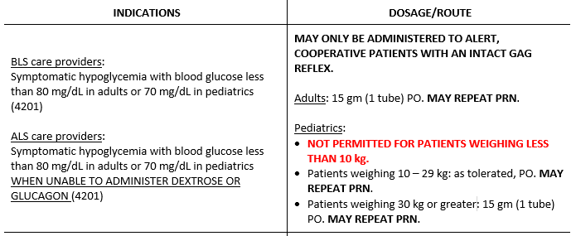
Medication Update: oral glucose policy affected: #4105, #4201 & #4801 change: dosing schedule modification for pediatrics only
Current language
New language
Purpose:
*Dosing oral glucose accurately can be difficult.
*Administration of oral glucose in the very young (i.e., less than 1 year old) is a choking hazard.

Slide 35
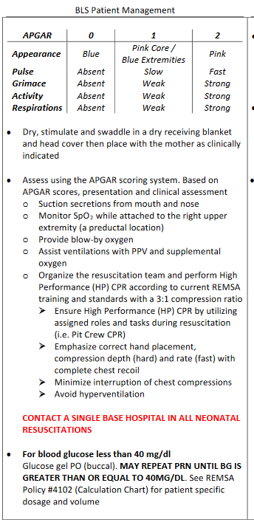
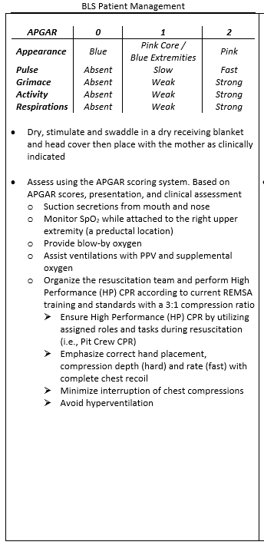
Medication Update: oral glucose policy affected: #4105, #4201 & #4801 change: dosing schedule modification for pediatrics only
Purpose: to align with the removal of oral glucose for all patients weighing less than 10 kg
Current language
New language

Slide 36
Medication Update: oral glucose policy affected: #4105, #4201 & #4801 change: dosing schedule modification for pediatrics only (CONT.)
Oral glucose: change in dosing schedule and formula for pediatrics only

Slide 37
Update to REMSA Policy #3308 ALS to BLS Downgrade Accompanying Education and clarifications
ALS to BLS DOWNGRADE ELIGIBILITY - PRIMARY / SECONDARY IMPRESSION
“Hypoglycemia that persists after oral glucose administration”
The onset of action of oral glucose is approximately five (5) minutes. If, within five to ten (5 – 10) minutes after administration, the rechecked blood glucose level is less than or equal to the sample taken that warranted initial oral glucose administration, the hypoglycemia may be considered “persistent.”
ALS to BLS DOWNGRADE ELIGIBILITY - VITAL SIGNS
“Trending vitals signs require A MINIMUM OF TWO SETS during the patient encounter.”
REMSA’s definition of “trending” aligns with the language included in the US DOT / NHTSA’s National Standard Curriculum for the EMT-Basic, which states that vital signs should be assessed and recorded every 15 minutes, at a minimum, in the stable patient and every 5 minutes in the unstable patient.

Slide 38
Update to REMSA Policy #4101 Introduction to Treatment Protocols change: updated language / referral to the pmdr
Current language
Updated language

Slide 39
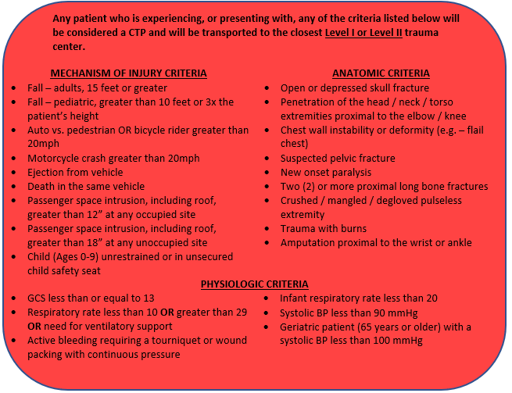
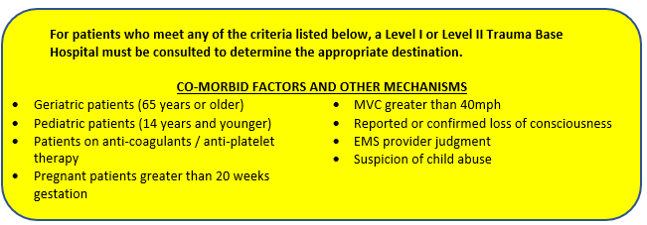
Update to REMSA Policy #5301 Trauma triage indicators and destination
New Mechanism of Injury Criteria
Child (Ages 0-9) unrestrained or in unsecured child safety seat
New Physiologic Criteria
Active bleeding requiring a tourniquet or wound packing with continuous pressure
New Co-morbid Factors and Other Mechanisms Criteria
Suspicion of child abuse

Slide 40
Update to REMSA Policy #7701 Patient Care Records
Changes to the language above will include references to the "collection of data for the improvement of local Public Health and Department of Social Services programs, to assist with County Coroner investigations, or to secure needed EMS resources or grant funding. When used for EMS resources and grant funding, all information collected is de-identified and reported in aggregate to prevent unintentional releases of PHI."
The verbiage changes are still in draft form and are subject to change prior to adoption and publishing.
COMING SOON:
An additional signature panel will be available in the ePCR in order to provide patients with the opportunity to "opt in" (i.e., provide explicit consent) to referral services outside of the 9-1-1 system. Services will include but not be limited to interventional programs involving substance use navigators, mental health & crisis services, homeless outreach, community based programs, etc.

Slide 41
Pediatric medication dosing resource the educational addendum formerly known as the calculation chart
What:
REMSA Treatment Protocol #4102 (Calculation Chart) is being renamed, de-numbered, and will no longer be identified as a treatment protocol; rather, it will be treated as an Educational Addendum (i.e., a reference tool that may be used at the paramedic’s discretion)
It will be called the Pediatric Medication Dosing Reference (PMDR) and will no longer be deferred to in any treatment protocol as needing to be seen “for patient specific dosage and volume.”

Slide 42
Pediatric medication dosing resource the educational addendum formerly known as the calculation chart (CONT.)
Why?:
Providers in the field have grown accustomed to utilizing the Calculation Chart for dosing pediatric patients. Unfortunately, after review, the Chart has been found to contain many inaccuracies and inconsistencies in both dosing and volumes listed, as well as in the formulas used to calculate those doses and volumes.
REMSA cannot knowingly publish a treatment protocol that directs providers to incorrectly dose patients when untoward patient outcomes could occur as a result.

Slide 43
Pediatric medication dosing resource the educational addendum formerly known as the calculation chart (CONT.)
Why? cont.:
Additionally, prescribing in protocol that providers must “See REMSA Policy #4102 (Calculation Chart) for patient specific dosage and volume” prohibits agencies that wish to use alternative pediatric treatment programs from being permitted to do so.
Identifying the PMDR explicitly as an educational/reference tool, along with the reintroduction of specific dosing calculations within each treatment protocol for pediatric patients, will help mitigate REMSA’s liability while producing more accurate dosing for the pediatric population.

Slide 44
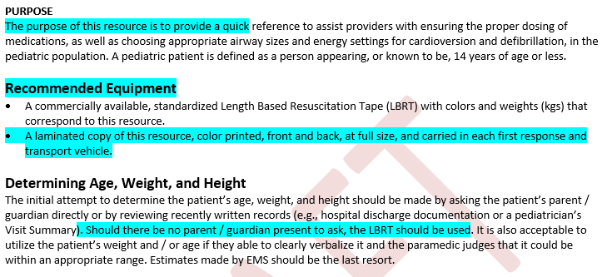
Pediatric medication dosing resource the educational addendum formerly known as the calculation chart (CONT.)
Introduction Page:
Previously: “…standardize medication dosages and volumes, airway sizes, and energy settings for cardioversion and defibrillation.
Previously: “Required”
The most accurate patient weight is obtained from the parent/guardian or by written record. If neither are available, the LBRT should be used to estimate.

Slide 45
Pediatric medication dosing resource the educational addendum formerly known as the calculation chart (CONT.)
Introduction Page, cont.:
“The PMDR is to be used as a reference tool only.”
Also included: point of care dilution instructions for
*Atropine
30 mg / 30 mL to 1 mg / 10 mL)
*Dextrose
50% and 25% to Dextrose 10%
*Epinephrine
1 mg / mL to 0.1 mg / mL
(from a SDV and an ampule)

Slide 46
Pediatric medication dosing resource the educational addendum formerly known as the calculation chart (CONT.)
New Layout Example:
Indications for administration now included
Inclusion of new colors / categories to help guide providers towards identifying appropriate dosing ranges in pediatric patients who don’t meet adult dosing criteria
Weight category overlaps due to pediatric obesity, and weight gaps due to growth spurts between the ages of 8-9, 10-11, and 12-13, are present
Inclusion of REMSA preferred concentrations
Inclusion of pharmacist verified dosing formula
Double dagger (“‡”) included to indicated max SINGLE dose

Slide 47
Pediatric medication dosing resource the educational addendum formerly known as the calculation chart (CONT.)
New Layout Example, cont.:
Medications that require a BHO prior to administration are still identified with BOLD RED font

Slide 48
Pediatric medication dosing resource the educational addendum formerly known as the calculation chart (CONT.)
New Layout Example, cont.:
There will be some instances in which a medication has multiple indications for administration. It is incumbent upon all paramedic providers to know when a BHO is required prior to administration, as a condition of a repeat dose , or both.

Slide 49
Resources
Hern, H. G., Kiefer, M., Louie, D., Barger, J., & Alter, H. J. (2016, December 5). D10 in the treatment of prehospital hypoglycemia: A 24 month observational cohort study. U.S. National Library of Medicine. Retrieved January 9, 2023, from https://pubmed.ncbi.nlm.nih.gov/27918858/
Hurtubise, M., Sterling, J., Greene, J., Carter, A. J., Swain, J., Brown, R., Fidgen, D., & Goldstein, J. P. (2021, October 4). Dextrose 50% versus dextrose 10% or dextrose titration for the treatment of out-of-hospital hypoglycemia: A systematic review. U.S. National Library of Medicine. Retrieved January 9, 2023, from https://pubmed.ncbi.nlm.nih.gov/34605385/
Weant, K. A., Deloney, L., Elsey, G., Combs, D., & French, D. (2019, November 26). A comparison of 10% dextrose and 50% dextrose for the treatment of hypoglycemia in the prehospital setting. U.S. National Library of Medicine. Retrieved January 9, 2023, from https://pubmed.ncbi.nlm.nih.gov/31769338/
Zofran ODT Orally Disintegrating Tablets, Oral Solution, and Tablets (ondansetron); (ondansetron hydrochloride) dose, indications, adverse effects, interactions... from PDR.net. Prescriber's Digital Reference. (n.d.). Retrieved January 10, 2023, from https://www.pdr.net/drug-summary/Zofran-ODT-Orally-Disintegrating-Tablets--Oral-Solution--and-Tablets-ondansetron----ondansetron-hydrochloride-244

